Slide 1
Types of Distributed Systems
Distributed computing systems
Cluster computing systems
Grid computing systems
Cloud computing systems

Slide 2
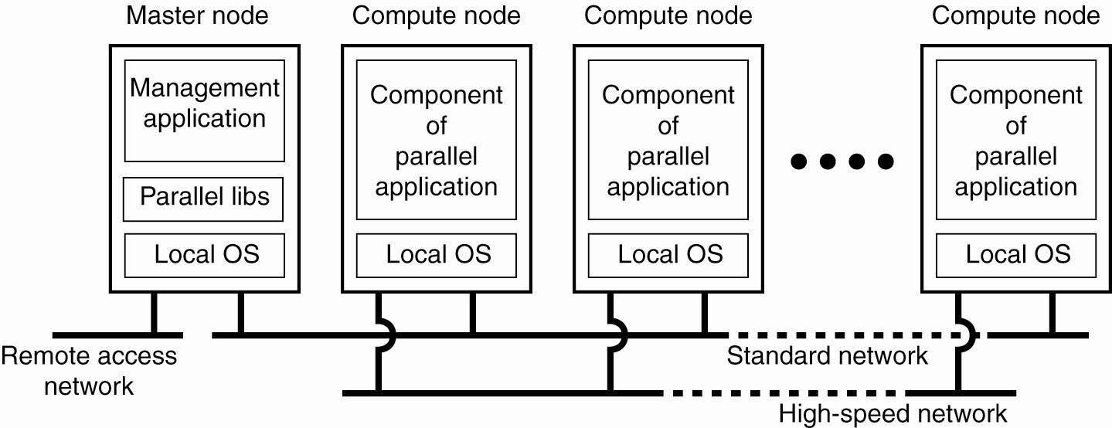
Cluster Computing Systems
An example of a cluster computing system

Slide 3
Grid Computing Systems
“Distributed Supercomputing”
Came out in the early 1990s, led by Ian Foster, et. al.
Enable communities (“virtual organizations, VO”)
Share geographically distributed resources
Pursue common goals, assuming the absence of central control, omniscience, trust relationships
Resources: HPC systems, visualization devices, storage systems, sensors, instruments, people, ….

Slide 4
Cloud Computing Systems
A computing paradigm that
Uses the Internet and remote servers to host data and applications for users by utilizing service-oriented architecture, virtualization and storage techniques (‘hosting’)
A large-scale distributed computing paradigm driven by
Economies of scale, pay as you go model
Virtualization, dynamically-scalable resources
Delivered on demand over the Internet

Slide 5
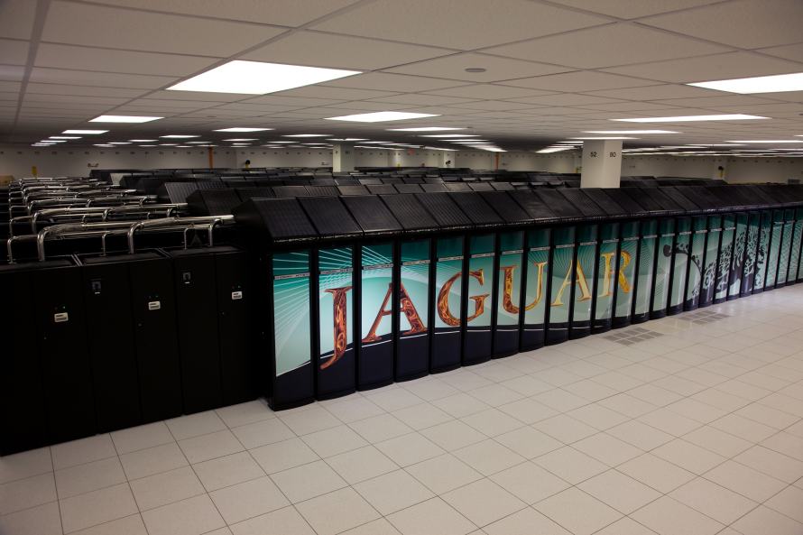
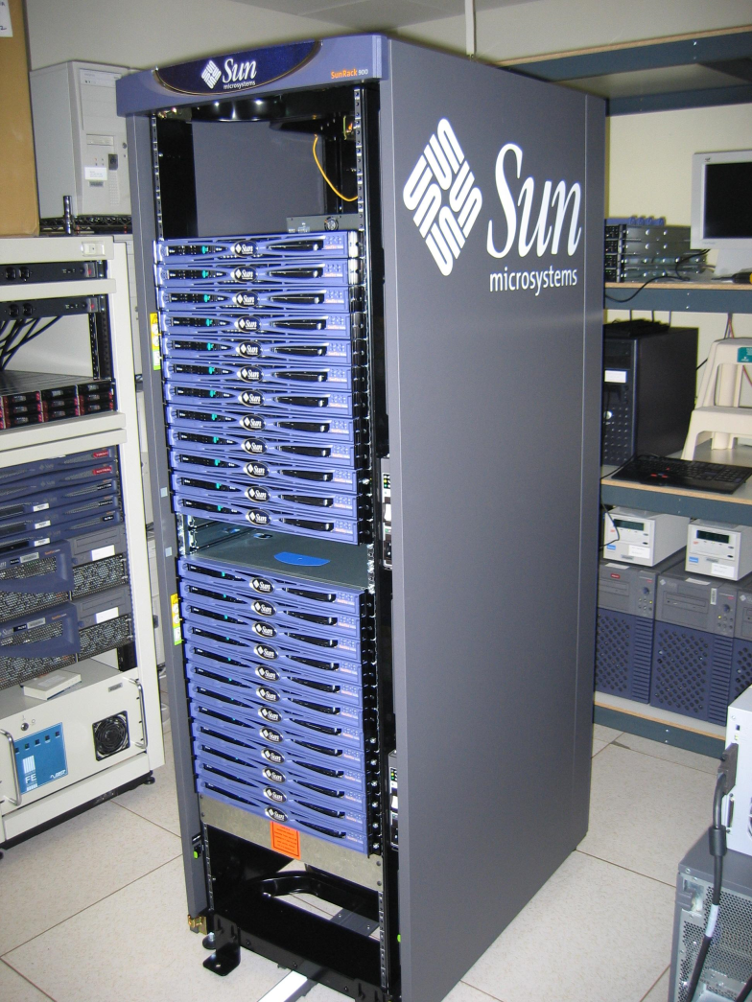
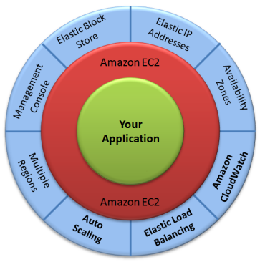
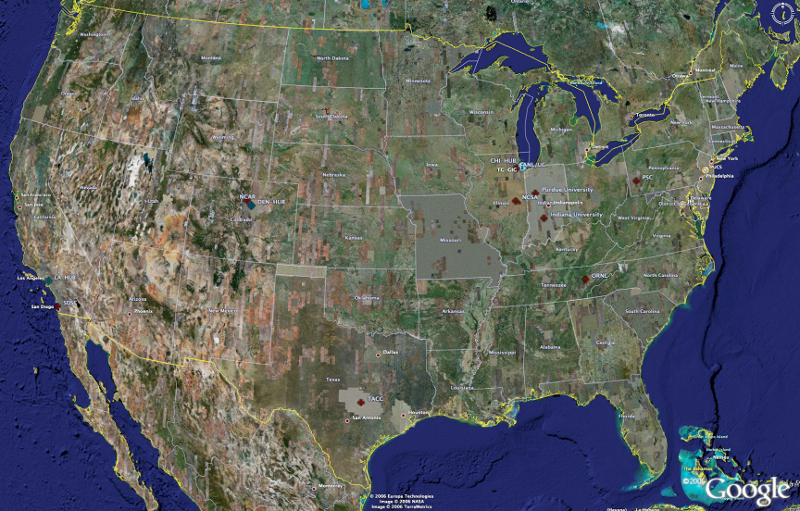
Clusters, Grids and Clouds
Computer clusters using commodity processors, network interconnects, and operating systems.
Grids tend to be composed of multiple clusters, and are typically loosely coupled, heterogeneous, and geographically dispersed
UC/ANL
PSC
PU
Clouds are a large-scale distributed computing paradigm driven by:
economies of scale
virtualization
dynamically-scalable resources
delivered on demand over the Internet
NCAR
NCSA
IU
2008
(~1PF)
ORNL
Tennessee
SDSC
2007
(504TF)
LONI/LSU
TACC

Slide 6
System Architectures
System architecture: depending on how software components placed and their interaction
Centralized architectures
Client-server model
Decentralized architectures
Peer-to-peer architectures
Hybrid architectures

Slide 7
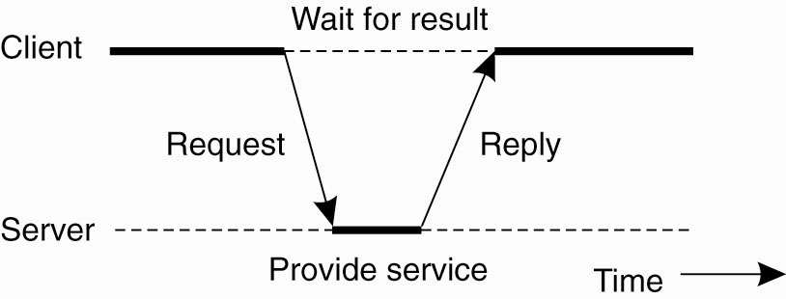
Centralized Architectures
Processes in a distributed system divided into two groups
Server: providing service
Client: requesting service
Request-reply behavior
Figure 2-3. General interaction between a client and a server.

Slide 8
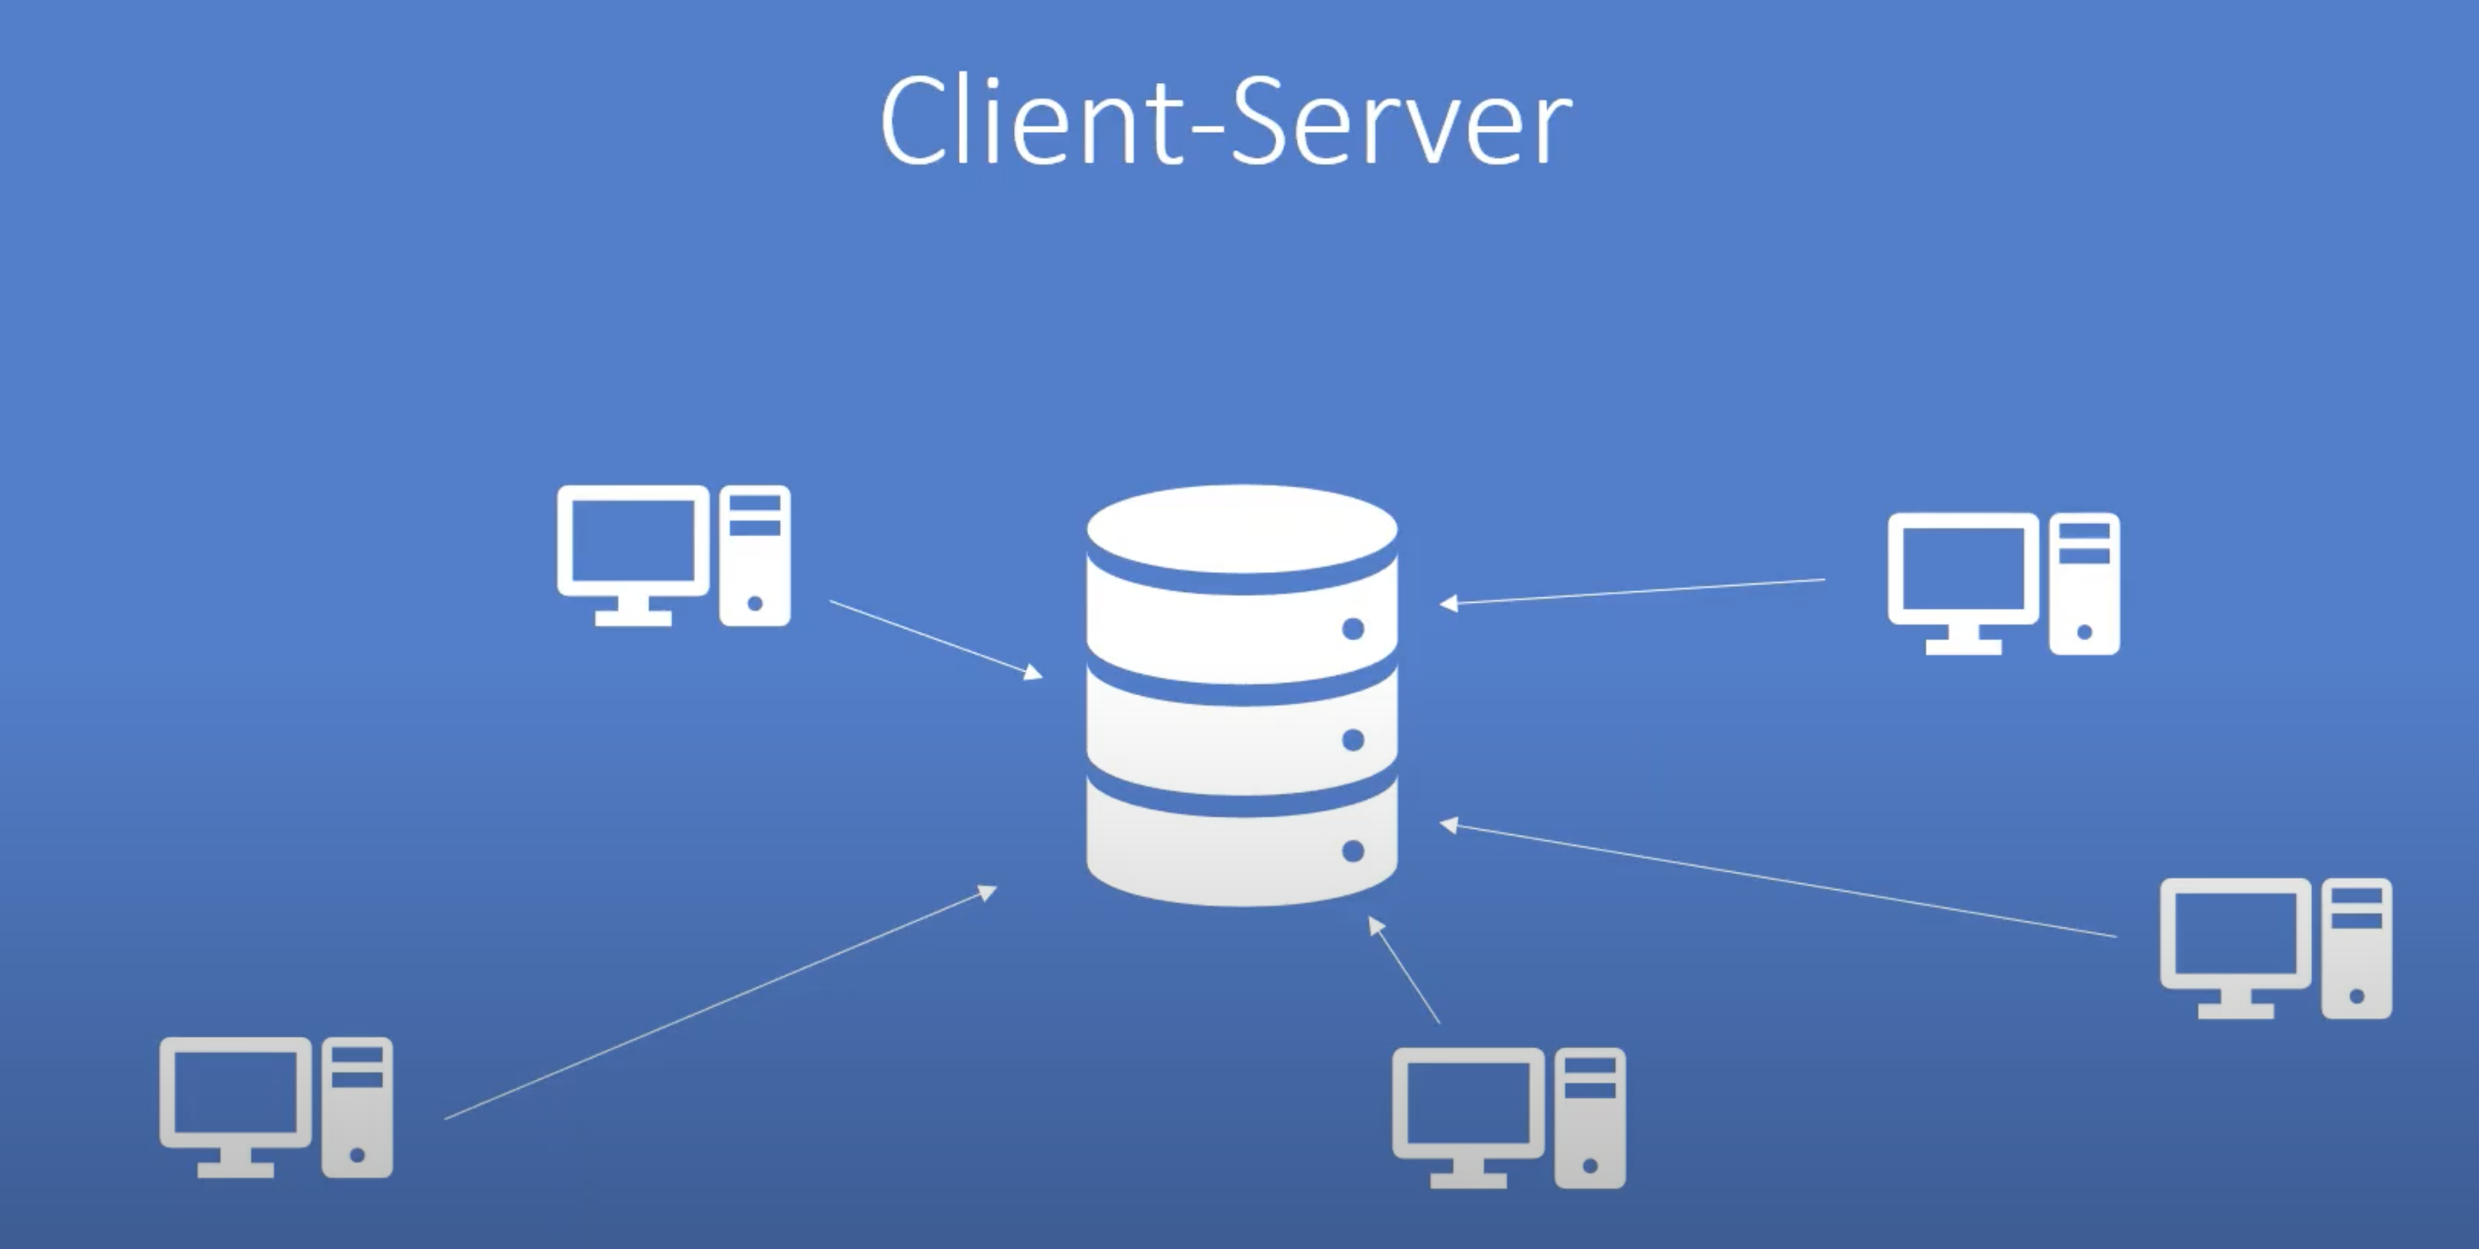
Application Layering for Client-Server Model
Surprisingly often no clear distinction between client/server
Many advocated a layering distinction
The user-interface level
The processing level
The data level
Example: Email server

Slide 9
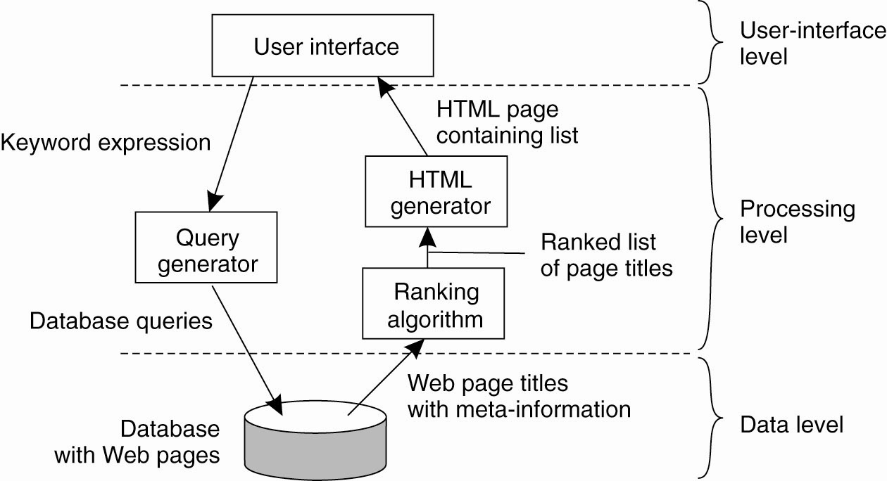
Application Layering for Client-Server Model
The simplified organization of an Internet search engine into three different layers.

Slide 10
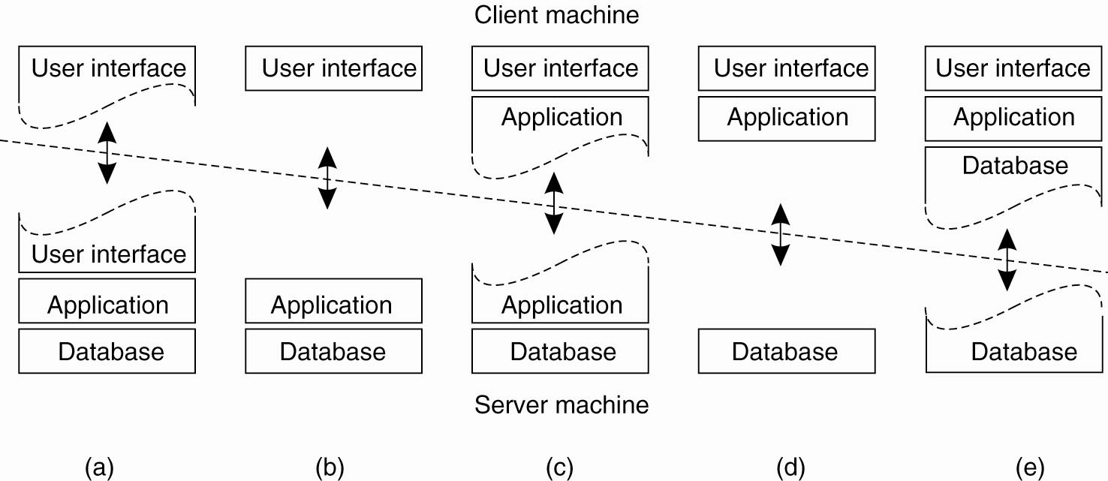
Multitiered Architectures for Client-Server Model
Thin clients
Fat clients
Figure 2-5. Alternative client-server organizations (a)–(e).

Slide 11
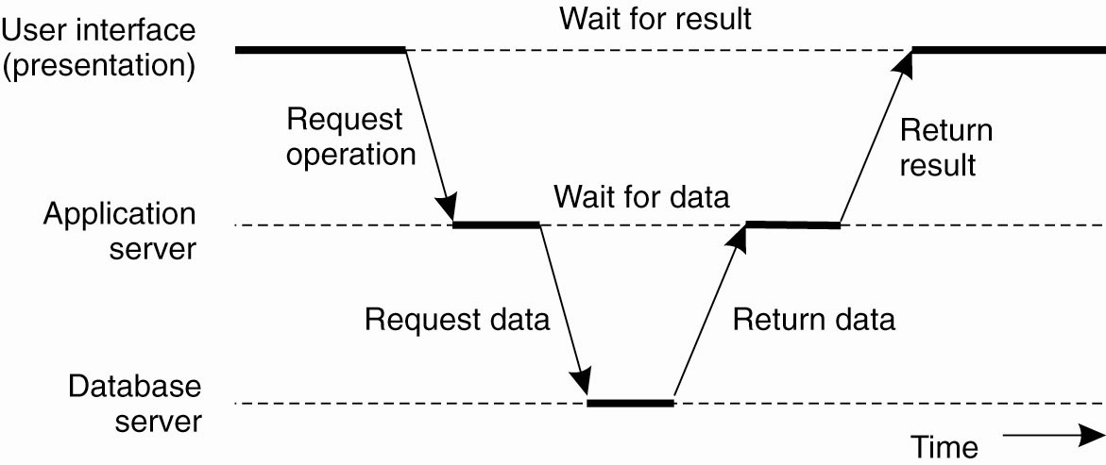
Multitiered Architectures for Client-Server Model
An example of a server acting as client.

Slide 12
Decentralized, Peer-to-Peer Architectures
Horizontal distribution
Physically split up into logically equivalent parts
Each part operates on its own share of data set and balance the load
Peer-to-peer (P2P) model
Processes are all equal (symmetric), both a server and client, “servent”
Overlay network: processes as nodes, communication channels as links, membership management

Slide 13
Structured Peer-to-Peer Architectures (1)
Overlay network is constructed using a deterministic procedure
Widely-used procedure: distributed hash table (DHT)
Data items assigned a random key from a large identifier space, e.g. 128-bit/160-bit
Nodes assigned a id number too
Using a deterministic scheme to map key and id
When looking up a data item, network address of node returned

Slide 14
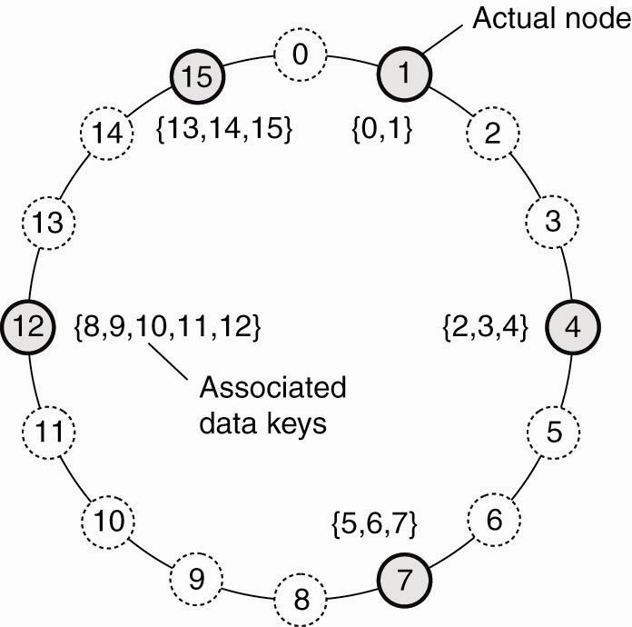
Structured Peer-to-Peer Architectures (2)
Chord system
Key k mapped to node with the smallest id: id>=k
Node referred as succ(k)
Lookup(k) returns succ(k)
The mapping of data items onto nodes in Chord.

Slide 15
Structured Peer-to-Peer Architectures (3)
Join:
Node starts with generating a random id
Lookup(id) returns succ(id)
Contact succ(id) and its predecessor and insert itself in the ring (nodes need store info of predecessor)
Transfer data items belonging to node id from succ(id)
Leave:
Node id informs departure to predecessor and successor
Transfer data items to succ(id)

Slide 16
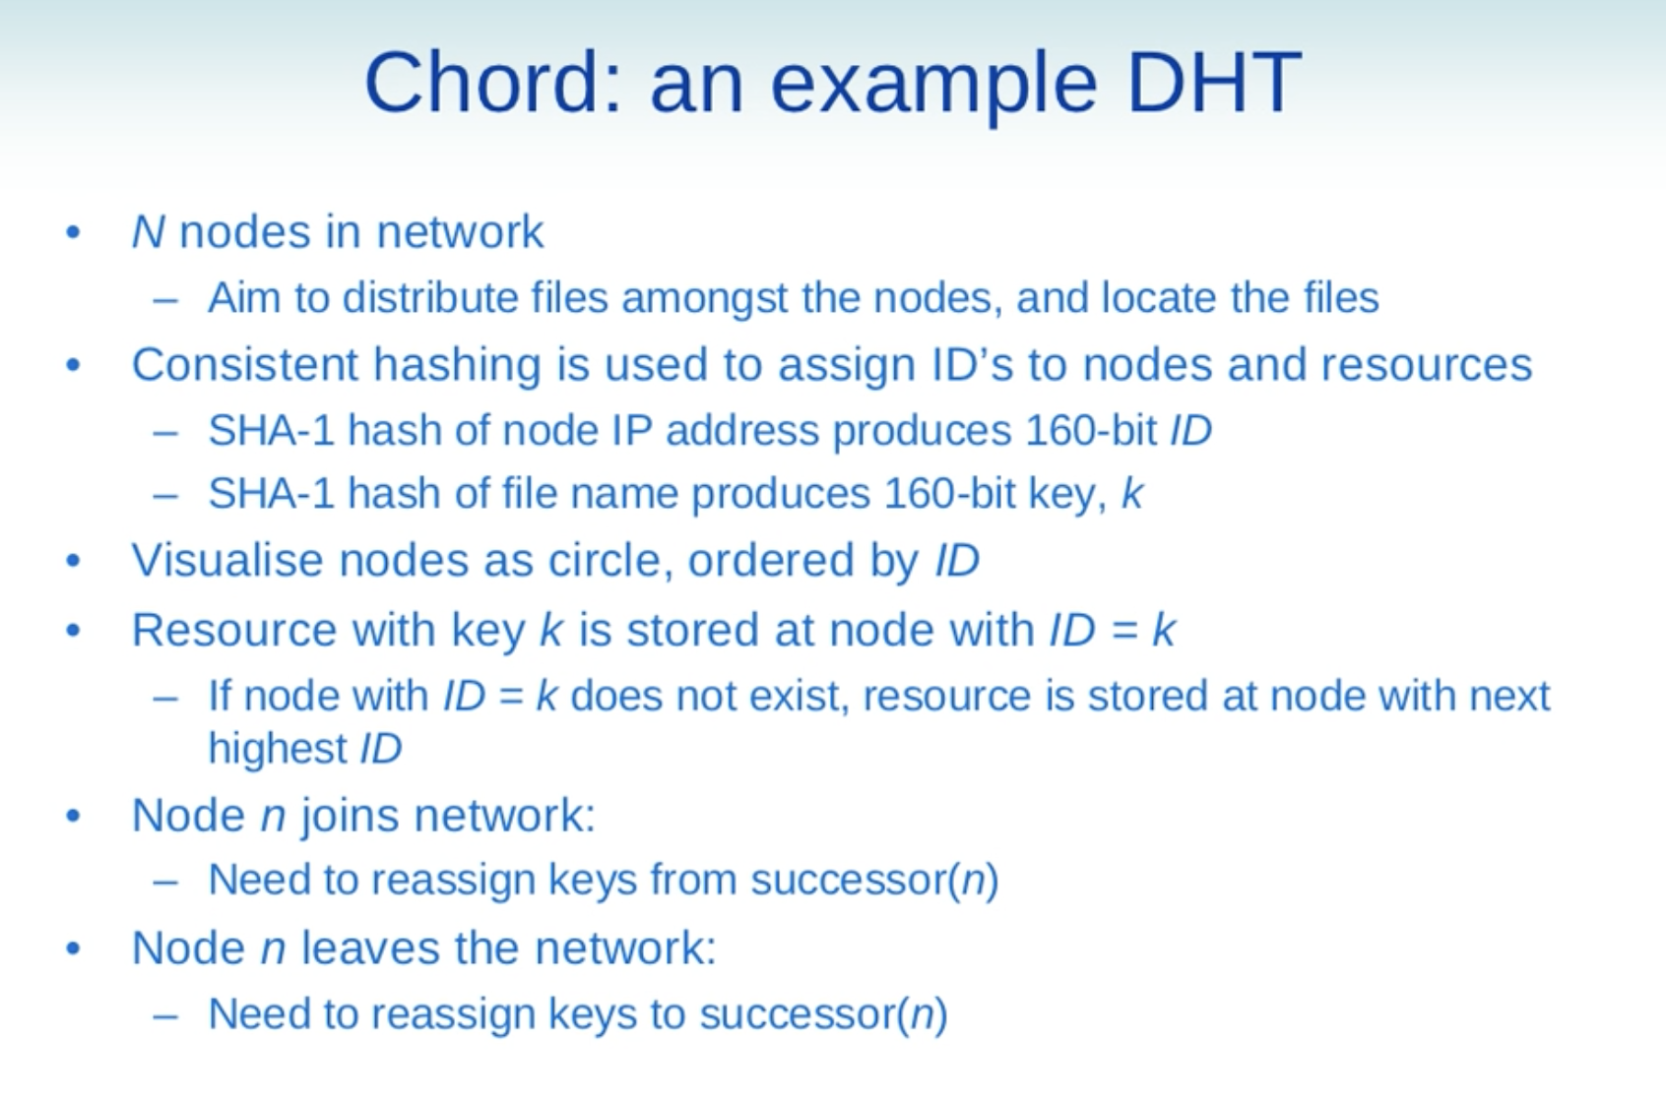
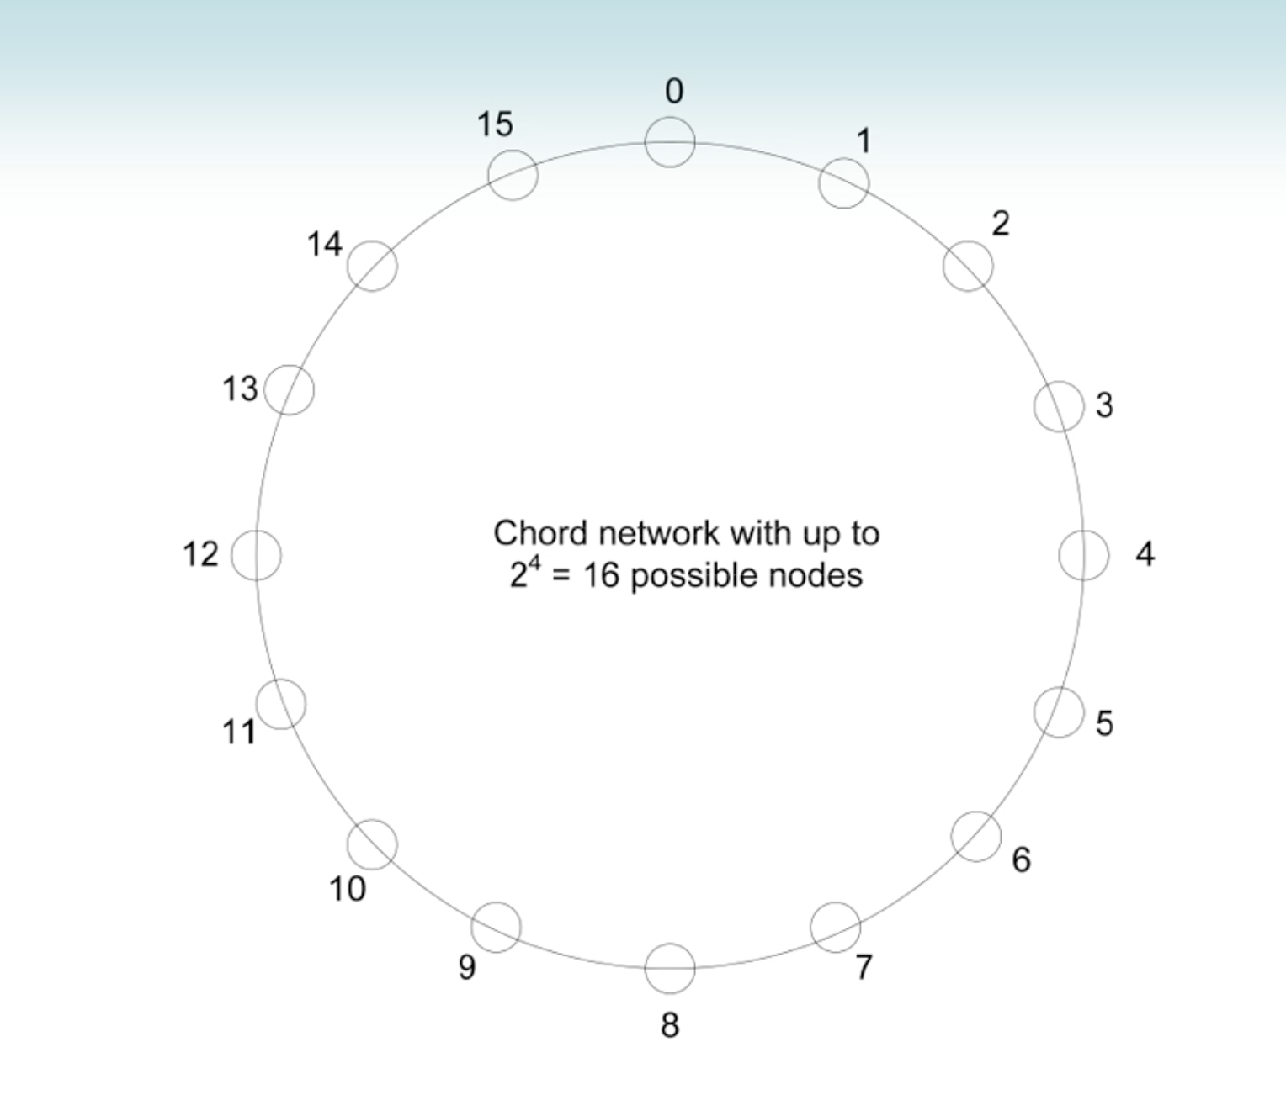

Slide 17
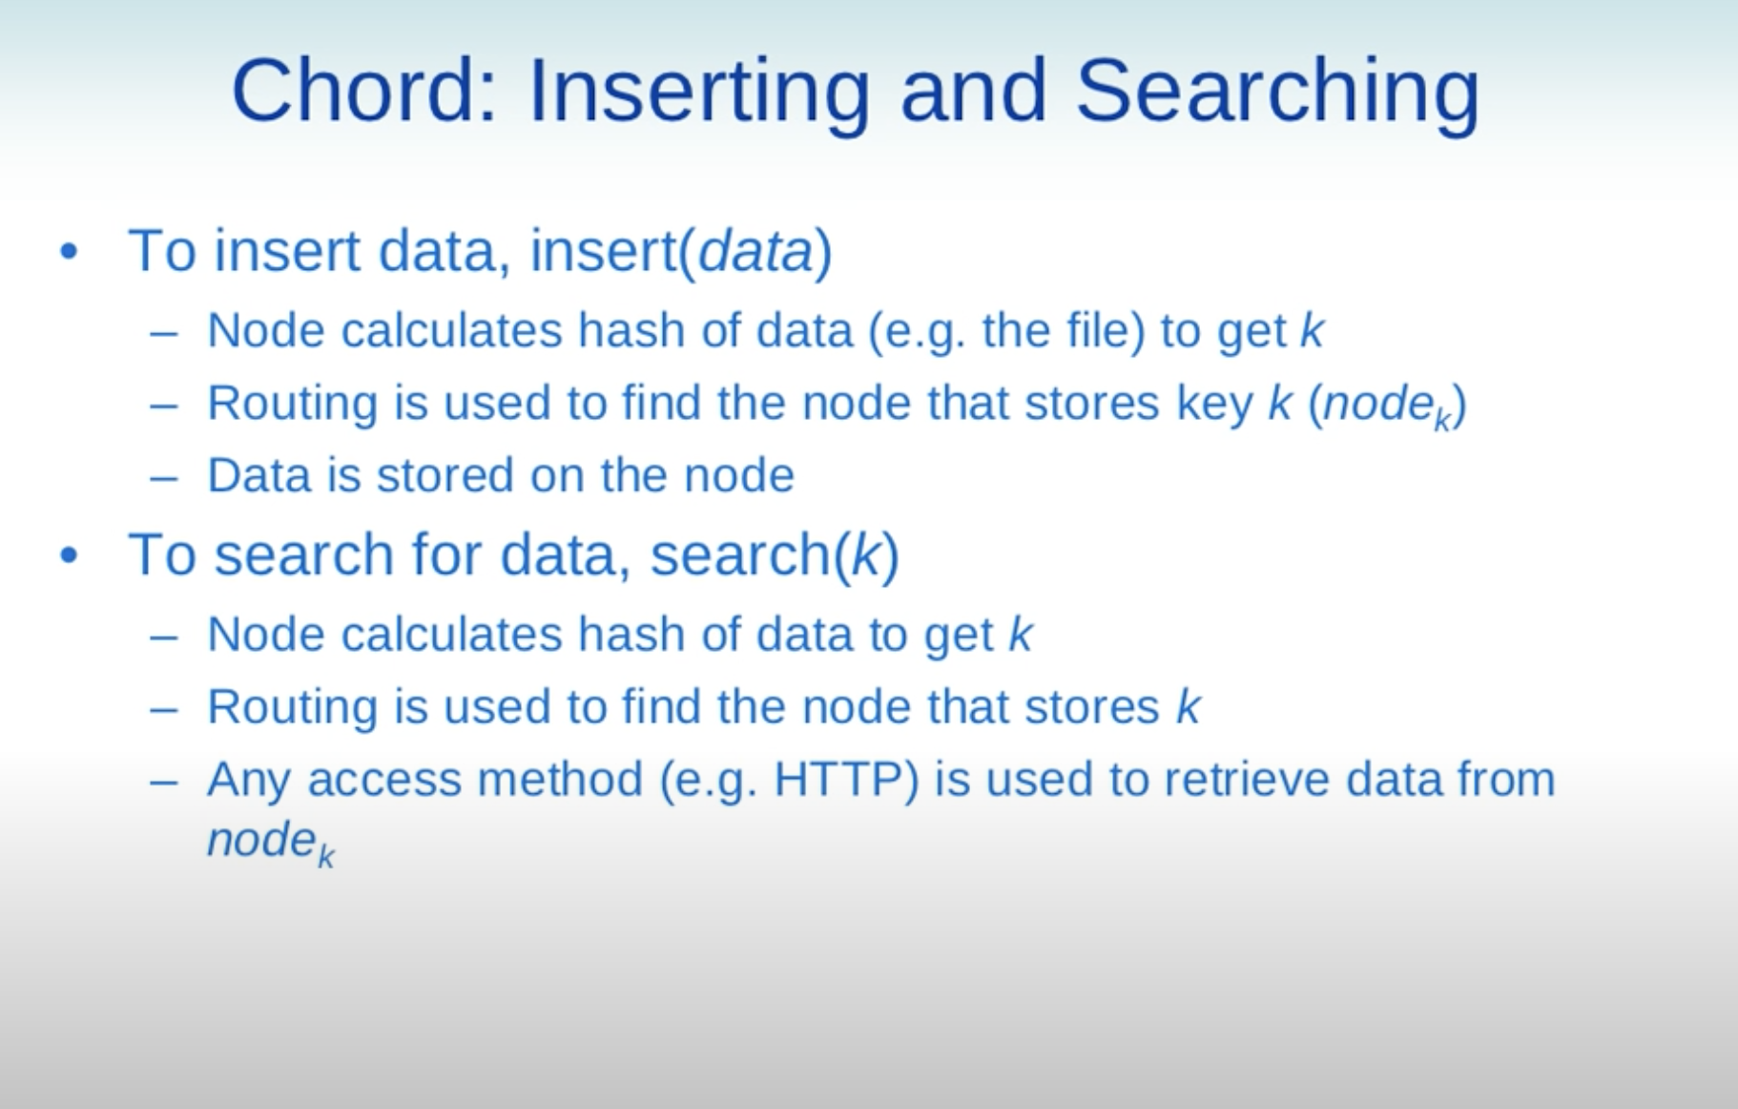

Slide 18
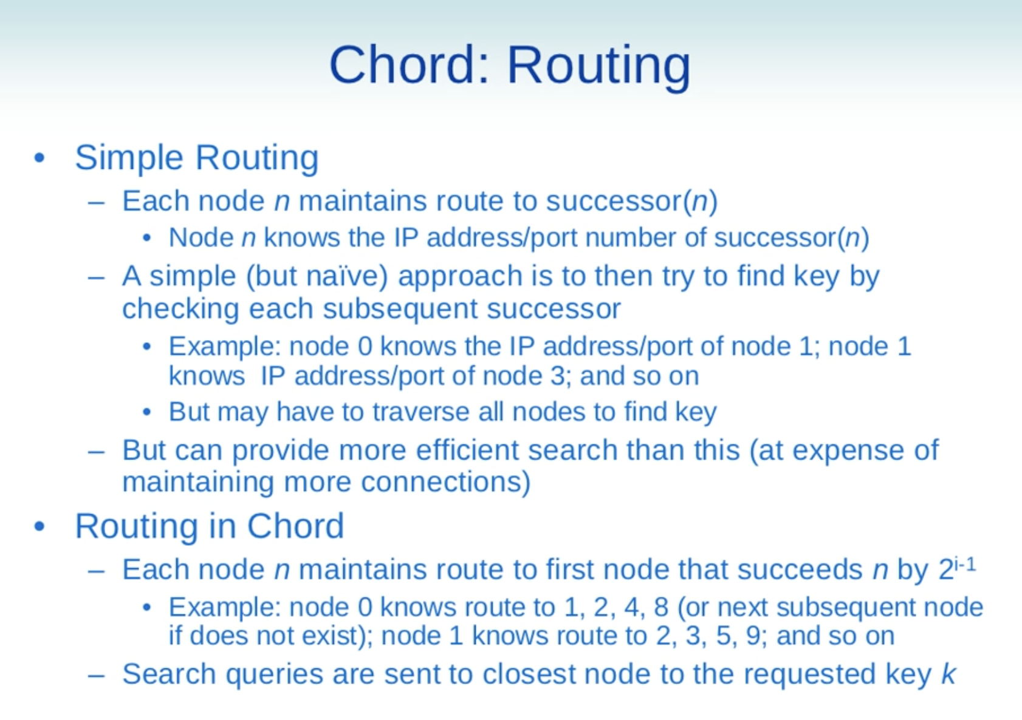

Slide 19
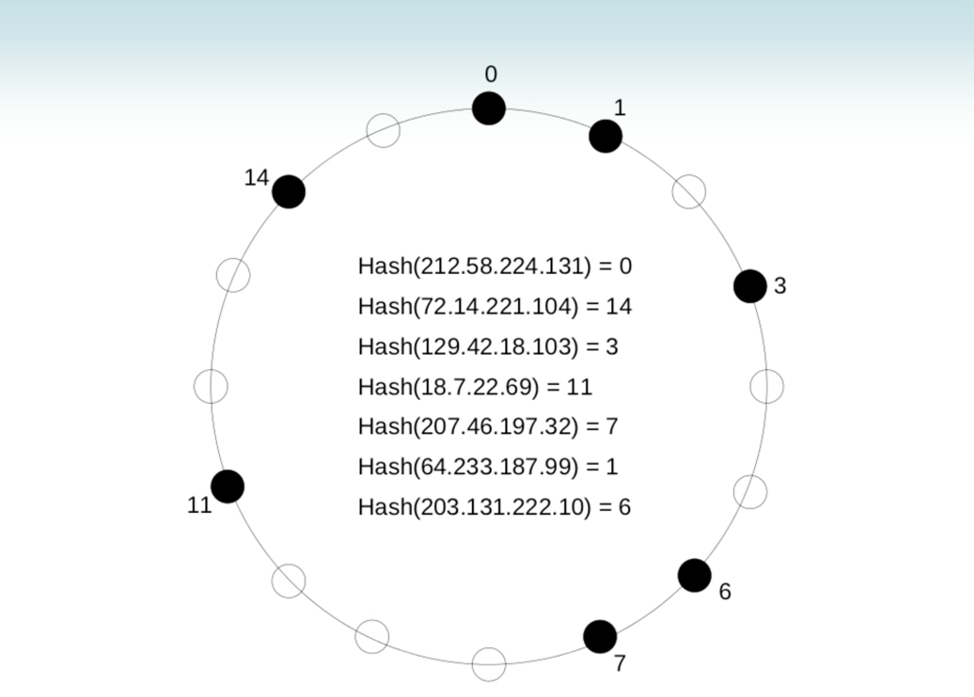
What is the maximum number of computer joined the network?

Slide 20
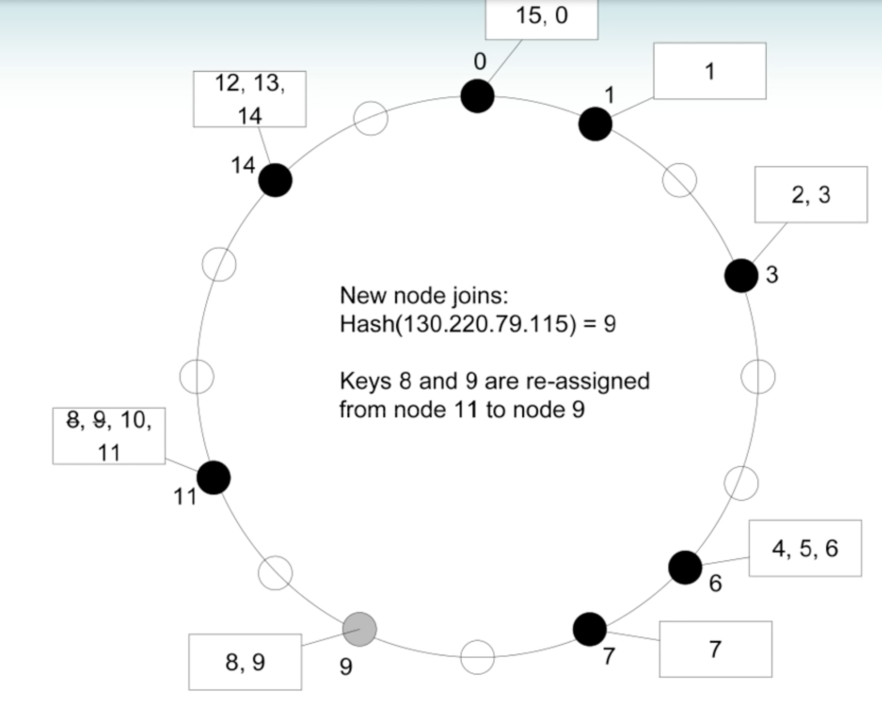
Join

Slide 21
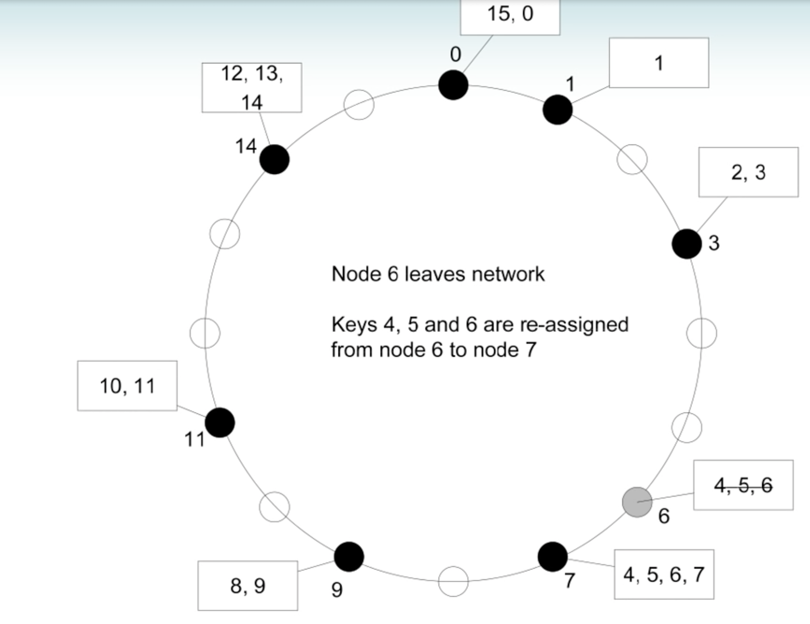
Leave

Slide 22
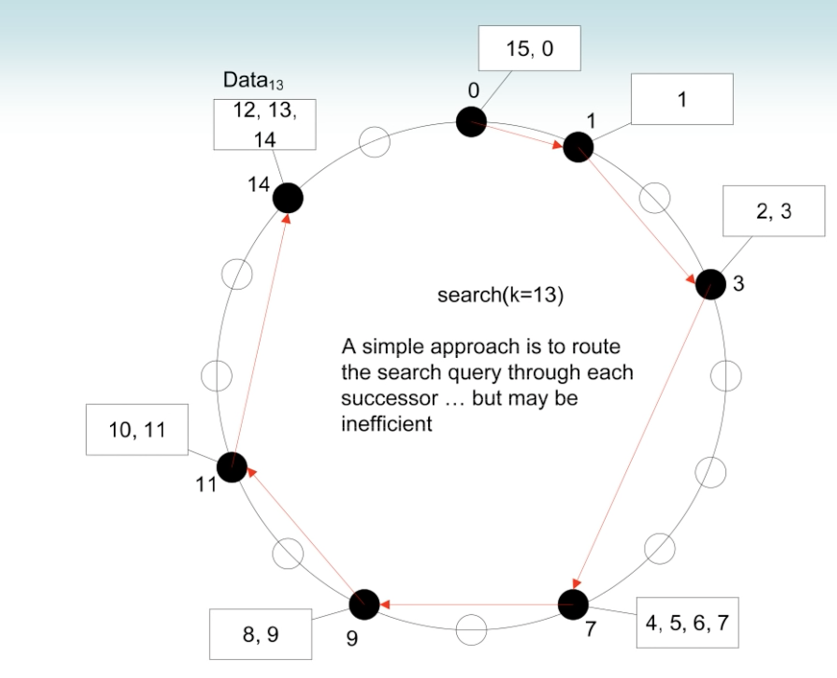
Search (Simple Routing)
What are the red links?
Routing table with simple entry
--> easy to update
Notes:
Red link is the reference (IP address) to the next available node.

Slide 23
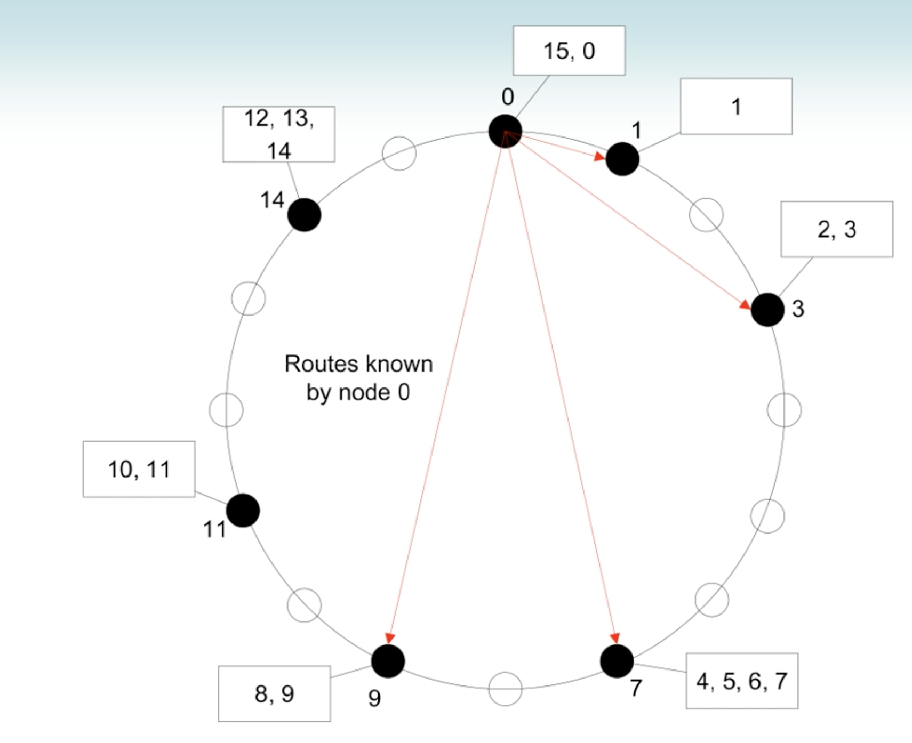
Chord Routing

Slide 24
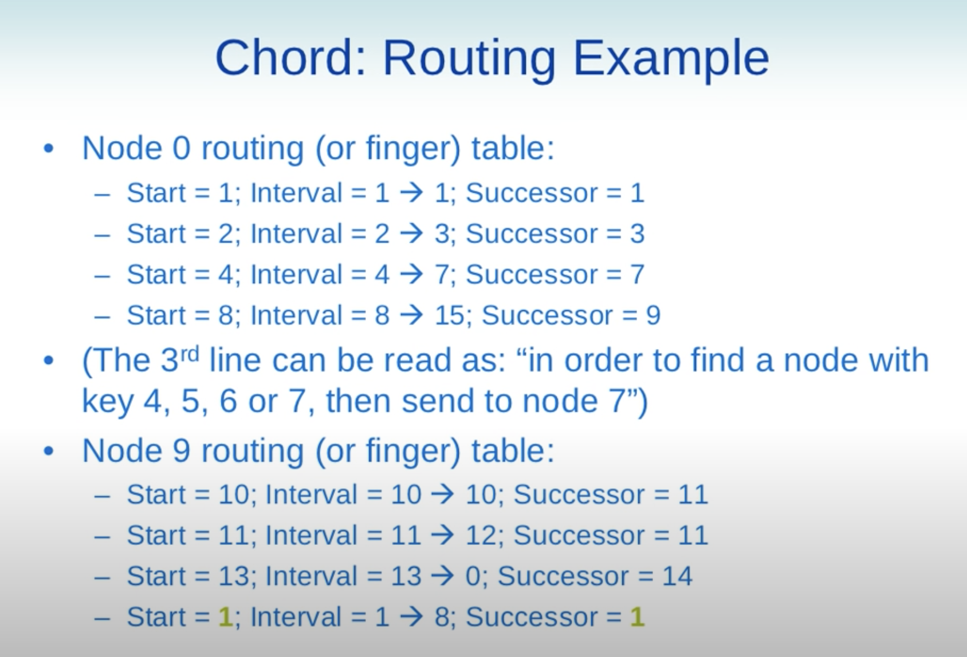
Chord Routing

Slide 25
Chord Routing
What is the routing table of node 0 when removing node 3.
EXAM question?

Slide 26
Chord Routing: From node 9

Slide 27
Chord Routing

Slide 28
Chord Routing
What is the routing table of node 9 when adding node 12.

Slide 29
Chord Routing

Slide 31
How many entries in the routing table for a ring of 16 nodes?
How many entries in the routing table for a ring of 32 nodes?
How many entries in the routing table for a ring of 1,000 nodes?
How many entries in the routing table for a ring of 1,000,000 nodes?
Notes:
n entries with n bits network

Slide 32
How many queries to be sent over the network for a ring of 16 nodes?
(in the worst case if we use 1 vs. n entries in the routing table)
How many queries to be sent over the network for a ring of 32 nodes?
How many queries to be sent over the network for a ring of 1,000 nodes?
How many queries to be sent over the network for a ring of 1,000,000 nodes?
Notes:
n entries with n bits network

Slide 33
When we only have a small number of available nodes (say 3), what do we have in the routing table?
Notes:
n entries with n bits network

Slide 34
Possible Questions:
Fill in the routing table (IP address of the referenced computers)
Sequence of query for a search

Slide 35
Benefit:
When a node joining or leaving the P2P network, only one node need to be updated.

Slide 36
Unstructured Peer-to-Peer Architectures (1)
Rely on randomized algorithms for constructing an overlay (logical) network
Each node maintains a list of neighbors
Data assumed to be randomly placed on nodes
Search query to locate a specific data item

Slide 37
Unstructured Peer-to-Peer Architectures (2)
Membership management
Each node maintains a list of c neighbors
Referred as a partial view
Each neighbor associated with an age
Nodes regularly exchange entries from partial view

Slide 38
Figures are from books and online resources
Distributed Systems: Principles and Paradigms (2nd Edition), by Andrew S. Tanenbaum and Maarten Van Steen
Publisher: Prentice Hall
ISBN-10: 0132392275
ISBN-13: 978-0132392273
Modern Operating Systems (4th Edition), by Andrew S. Tanenbaum Publisher: Prentice Hall
ISBN-10: 013359162X
ISBN-13: 978-0133591620

